Slide 1


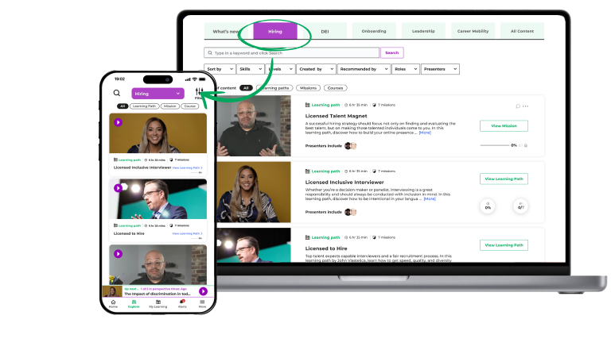
Hire, Lead, and Engage with SocialTalent
Date

Slide 2




SocialTalent + Customer Name
Today’s agenda
Our team objectives - Cognizant BU (10 mins)
Learning expectations - Cognizant BU (10 mins)
Our learning program - Aoife ST (5 mins)
SocialTalent platform tour - Aoife ST (15 mins)
Best practice - Aoife ST (5 mins)
Questions - Cognizant/Aoife ST (15 mins)

Slide 3

Our TA/Hiring Objectives
1
2
3
4
(Reduce time
to hire)
(Create a
world-renowned candidate experience)
(Increase representation of diverse groups in our business)
(Ensure career development opportunities for all staff)

Slide 4
Our Path to success
Reduce time to hire
1.New process segmented by candidate type
2.Implementation of new sourcing tools
3.Learning on sourcing & candidate engagement
Candidate Experience
1.Collect candidate NPS
2.Project team for seamless experience
3.Automated alerts in ATS for follow ups
4.Learning on understanding candidates
Diversity
1.Focus group of current staff – collect and use feedback
2.Blind resume screening
3.Track our metrics
4.Learning on sourcing for diversity and inclusive recruiting
Career Progression
1.Defined career pathways in TA
2.Hyper-relevant learning programs to support this
3.Learning for managers on internal mobility

Slide 5




What your learning looks like
Practice
new skills daily
Bi-weekly
30 minutes
Put new skills into practice right away
We will host some roleplays and workshops too!
team discussions
weekly learning
Come prepared to share your takeaways, feedback and practice
Combination of your learning path and exploring other topics
‹#›

Slide 6
Our partners in SocialTalent
Your Name here
Senior Customer Success Onboarding Specialist
first.last@socialtalent.com
What will you learn?
How to navigate the SocialTalent mobile app and learning platform
Learning best practice
Q&A

Slide 7
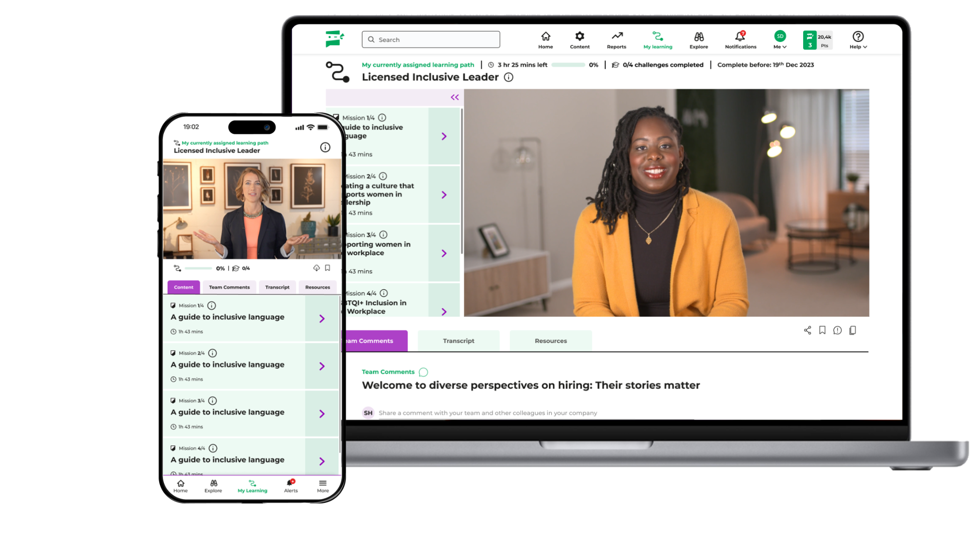
SocialTalent empowers organizations to hire, lead, and engage top talent.
Recruiting, Interviewing, Onboarding, DEI, Internal Mobility, and Leadership training content.​
Inclusive learning platform with video, audio, and text-based options.​
Scalable and secure learning environment.​
Easily integrate with learning management systems.*​
New content released regularly.​
Available in multiple languages.**​
*Premium add-on​
**Provided in English by default.​

Slide 8
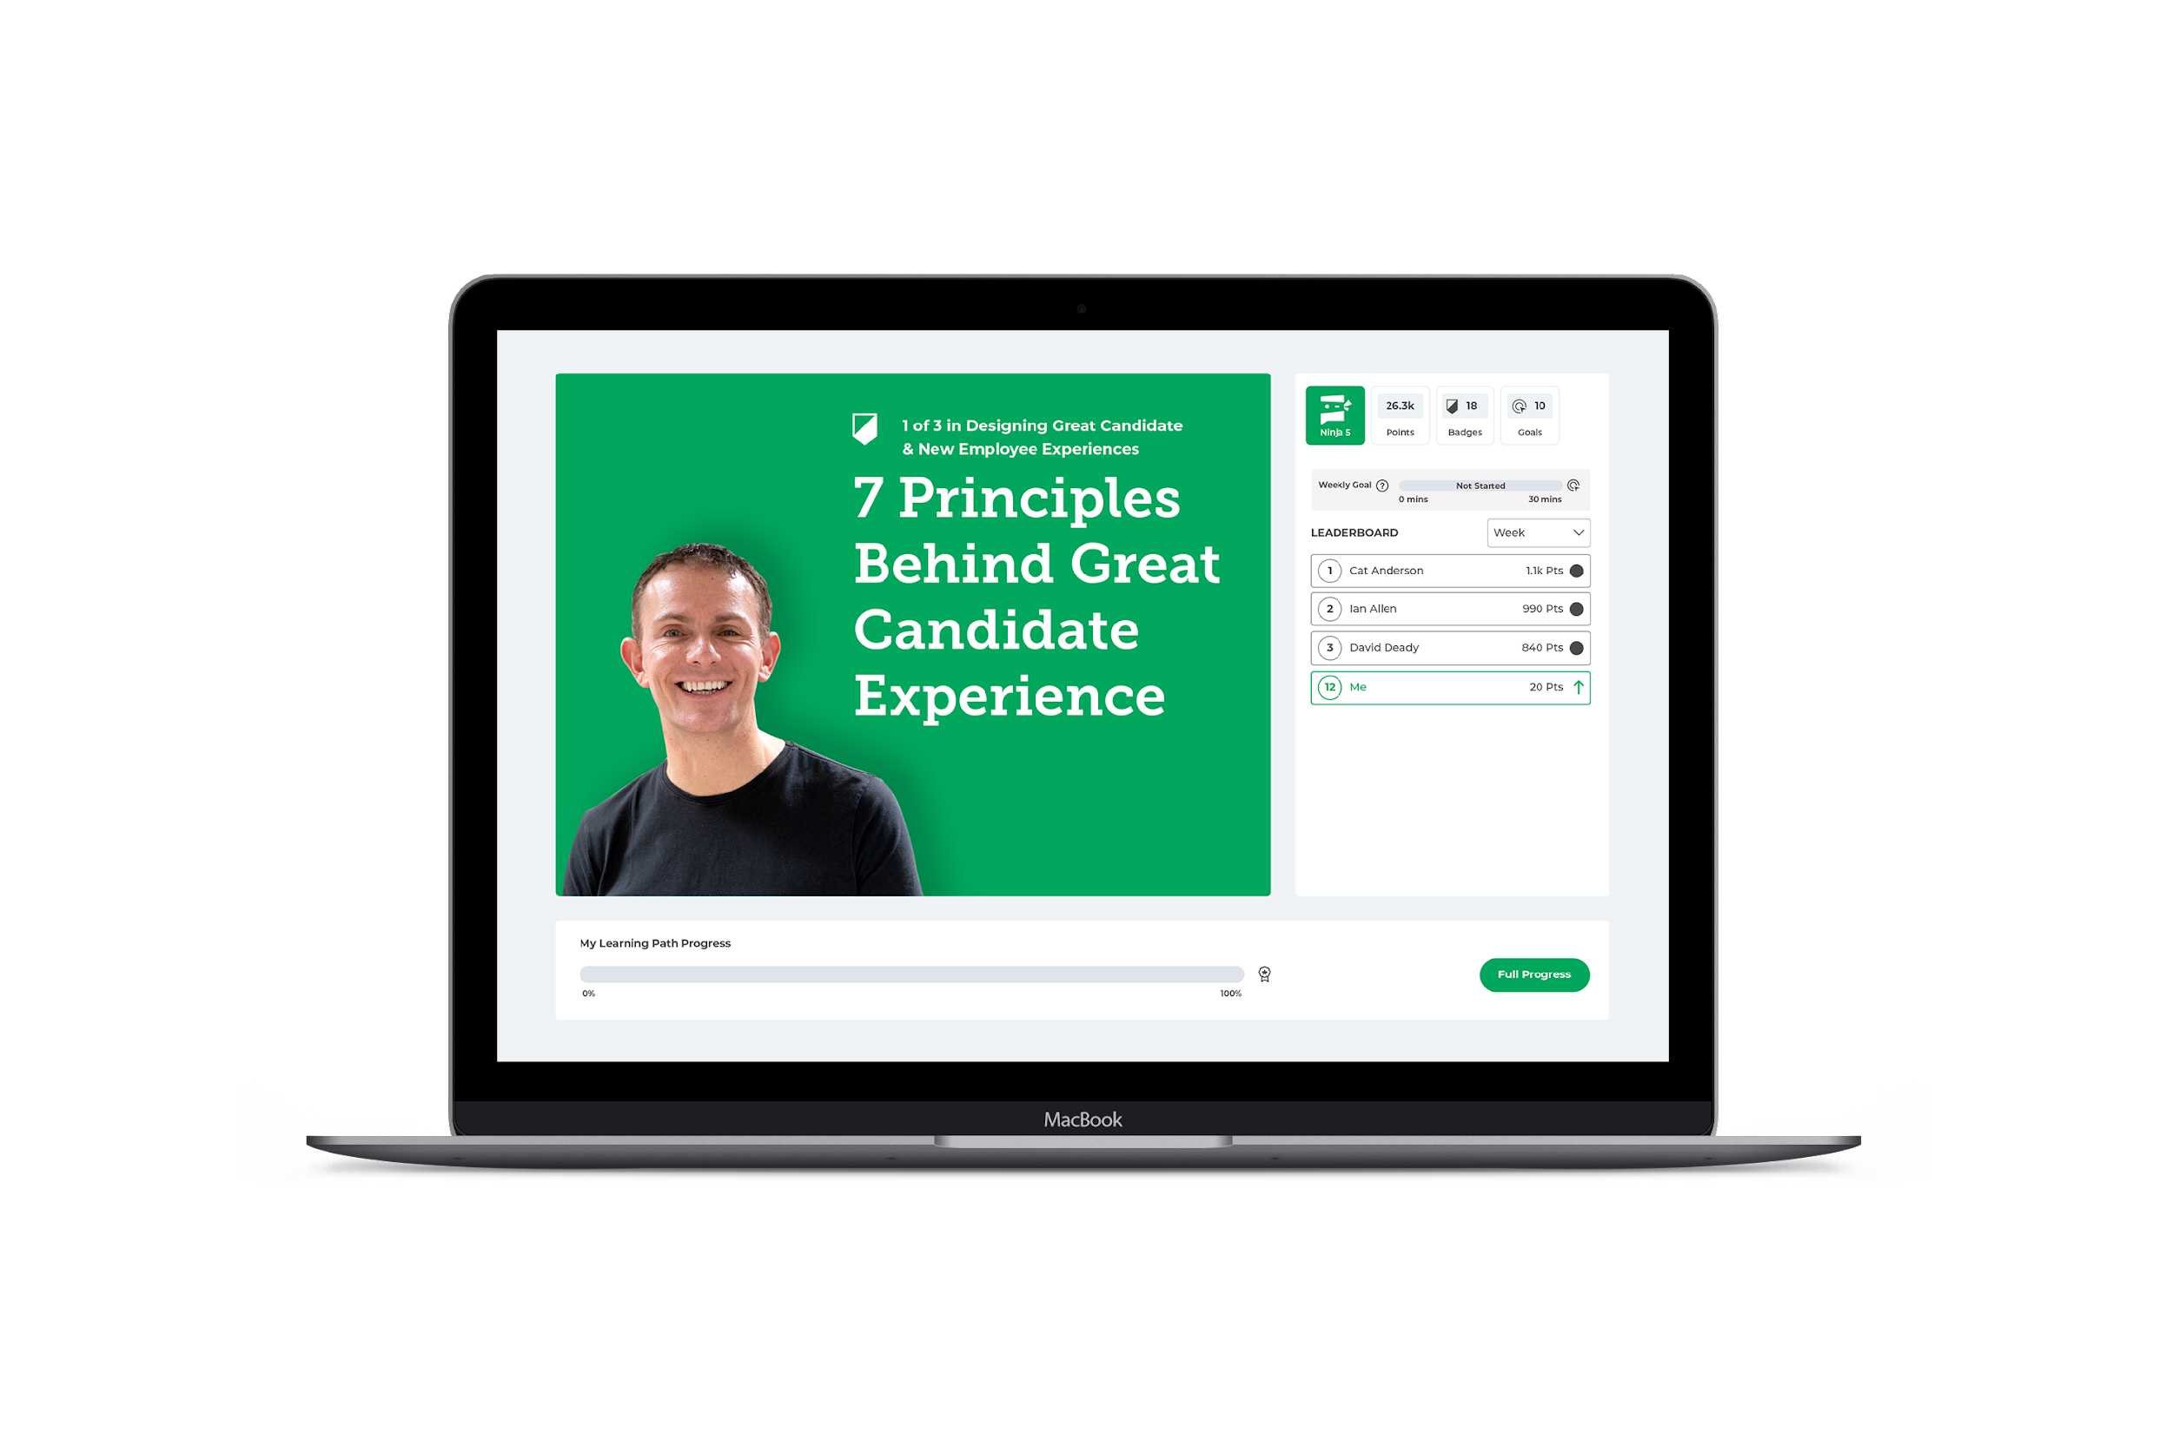
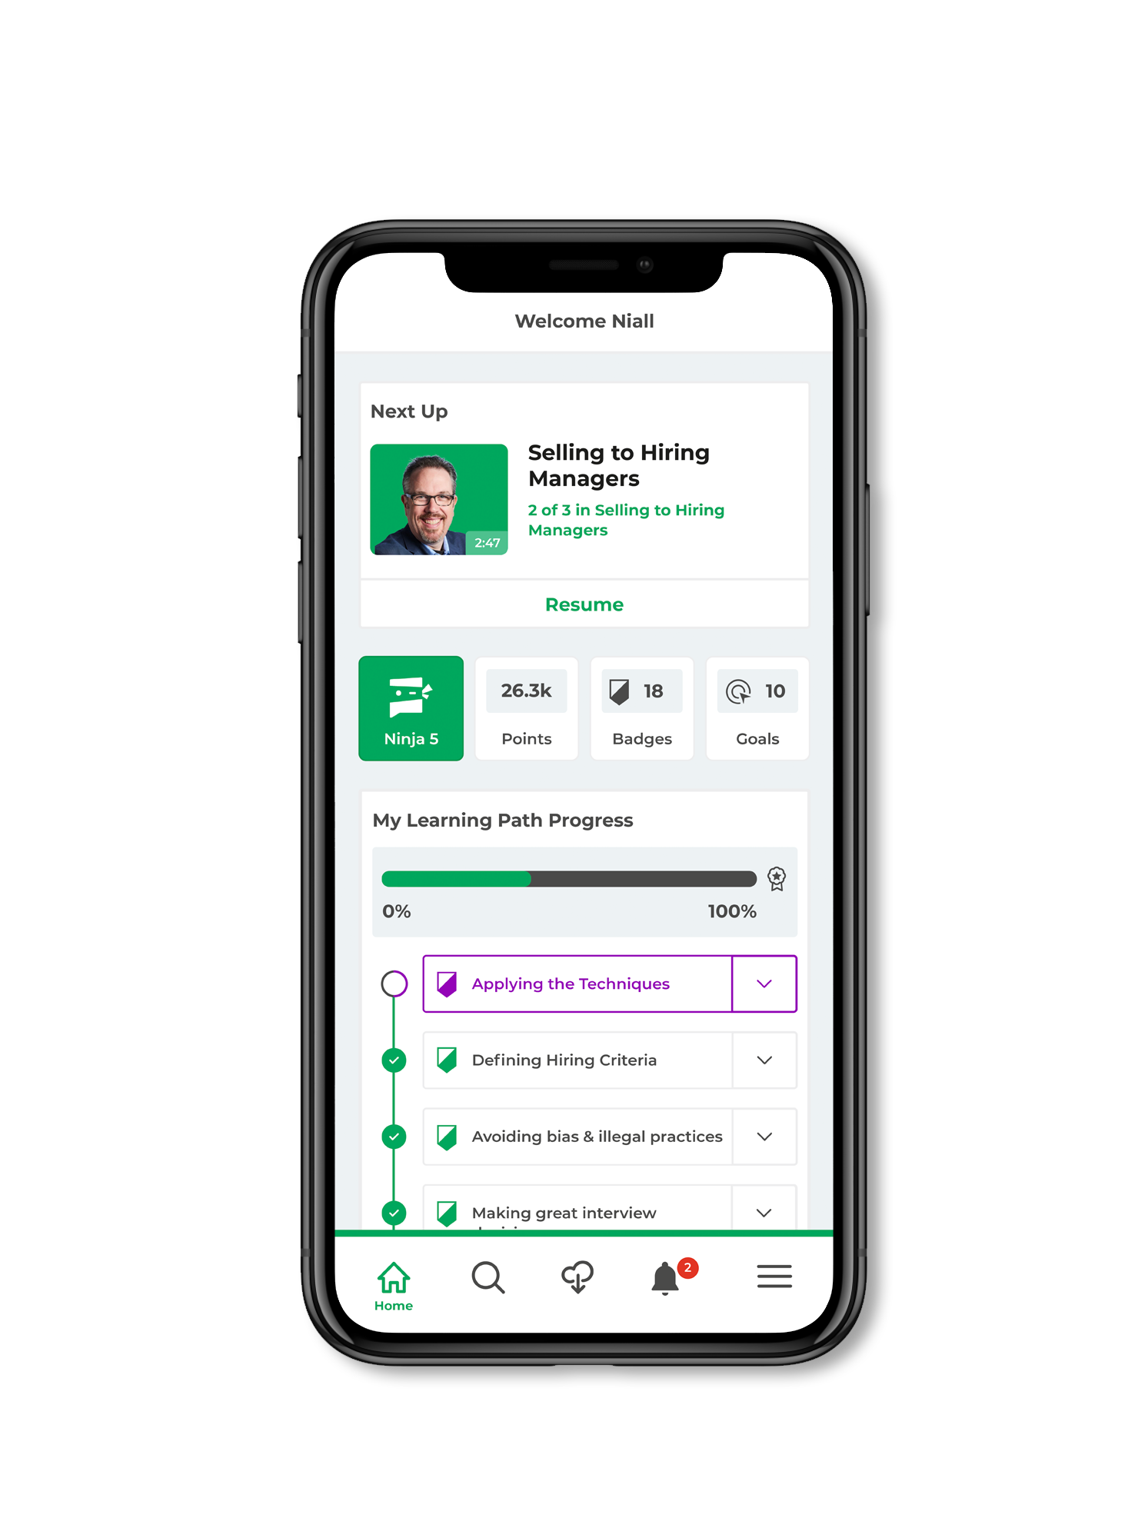
There are two ways to access your learning
Use the method that works for you!
Mobile App
Learn on the go with
listen-only mode,
podcast-style learning,
use with Alexa &
speakers
Desktop
Complete technical
learning (eg. Sourcing)
at your computer so
you can practice while
you learn

Slide 9

Your Q1 Learning Path
TBC and updated if needed
Licensed Candidate Management Specialist
Candidate experience:
  What candidates really want
Candidate experience:
  How candidates decide their next move
How to give great feedback to candidates
Duration:
Completion date:
31st July
Weekly learning goal:
30 mins

Slide 10
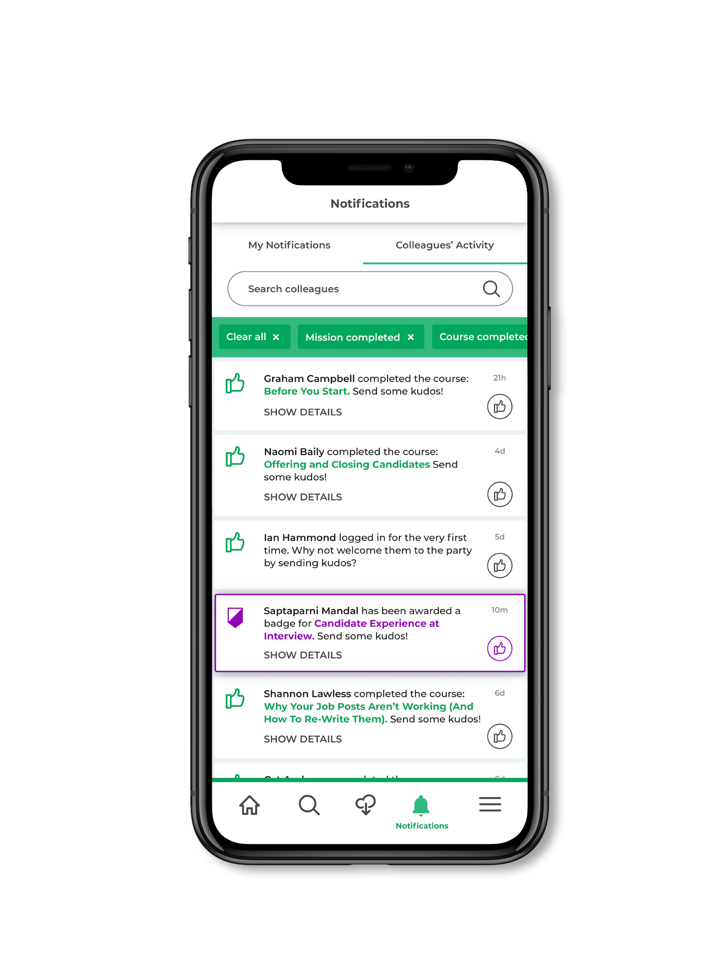



Mobile Tour
Install by searching: SocialTalent
Login with single sign on/your password

Slide 11

A Successful Learning Program Requires a Strong Team
Our Organization:
Role | Description | Responsibilities
Account Manager | Steward of the relationship between SocialTalent and your organisation. | Oversees the partnership between ST and your organisation. Ensures strategic alignment & value delivery Main POC for your Exec Sponsors Drives strategic alignment meetings, such as QBR's Oversees all commercials (e.g. contract renewals, etc.)
Onboarding Specialist | Oversees all aspects of your set-up, with a view of accelerating your time to value. | Assists with platform & learning configuration Coordinates with ST technical resources to deploy integrations Provides training to PM's & Admins Supports your team through initial launch Contributes to Mutual Success Plan (MSP)
Customer Success | Provides resources & guidance on how best to meet your objectives. | Partners with your Program Manager to help drive your ST learning program Drives the Mutual Success Plan (MSP) Provides guidance & resources to maximise learner engagement Drives Program Health Review meetings & attends other meetings such as QBR's
Customer Support | Resolves technical/platform issues experienced by learners & admins. | Responds to all support tickets Troubleshoots end-user issues Liaises with ST Product team to resolve bugs
First Time Login

Slide 12
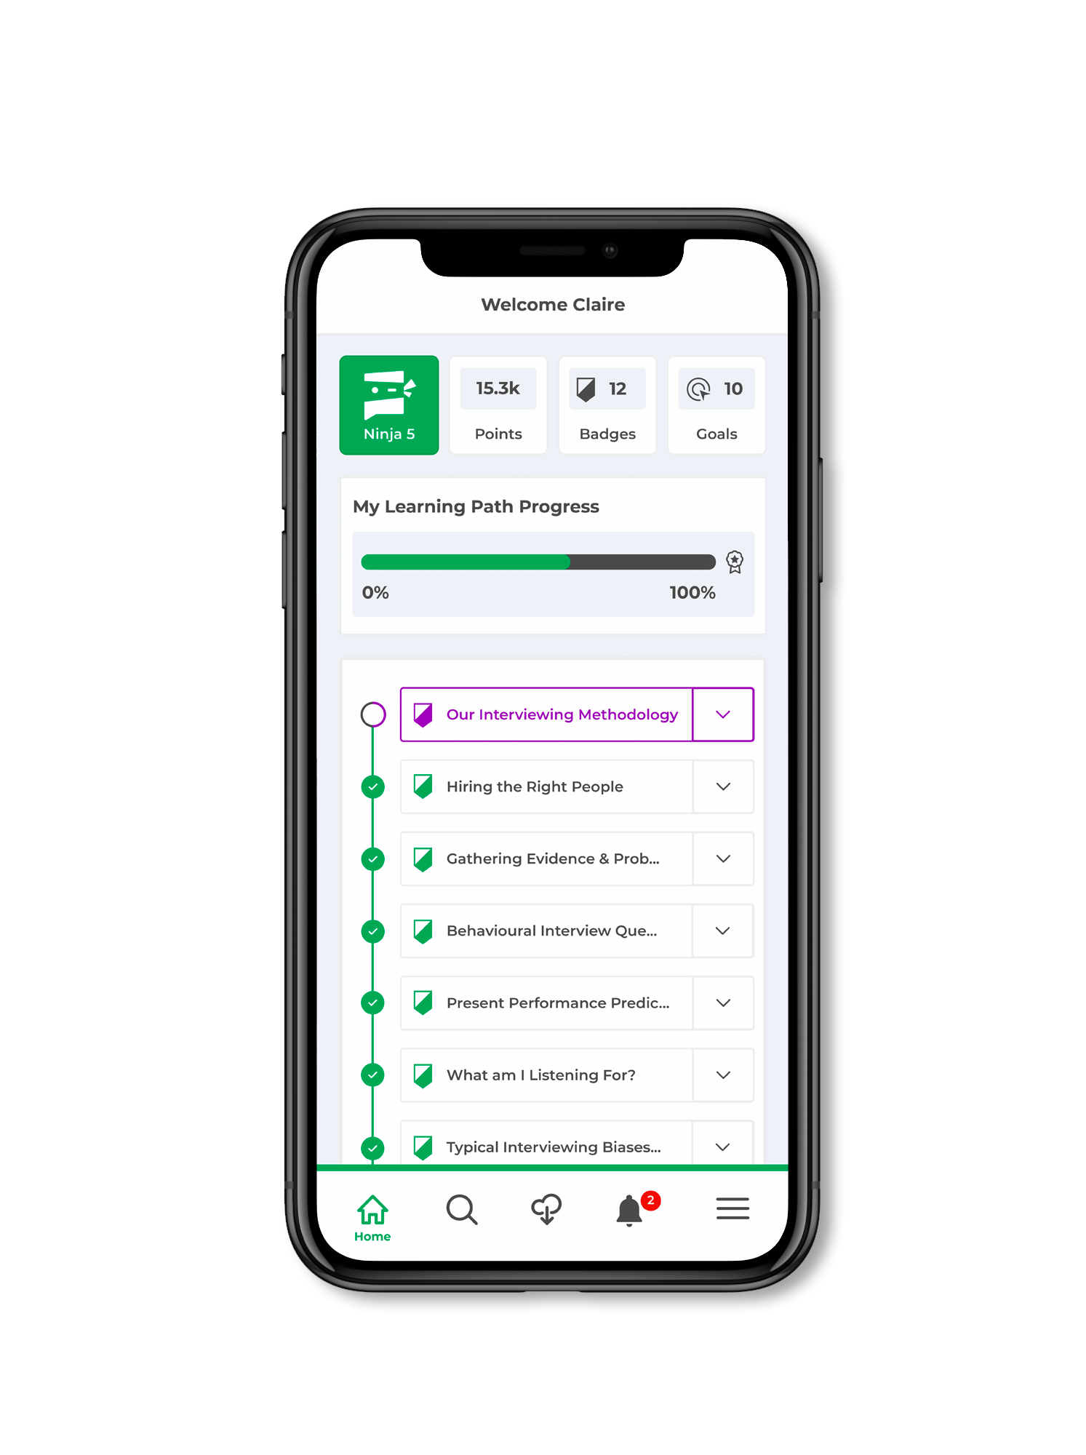
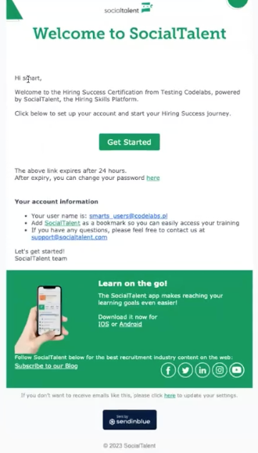
Welcome To SocialTalent

Slide 13
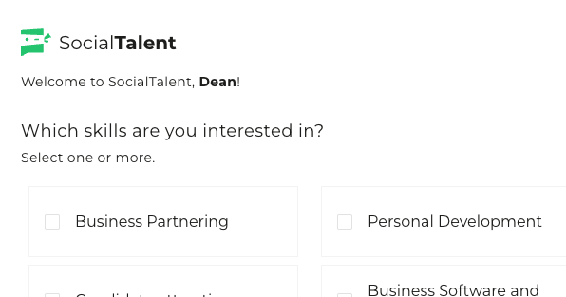
Welcome To SocialTalent

Slide 14
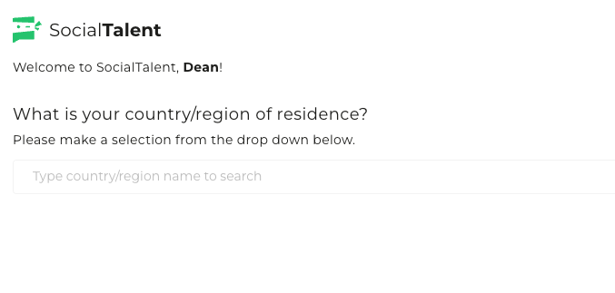
Welcome To SocialTalent

Slide 15
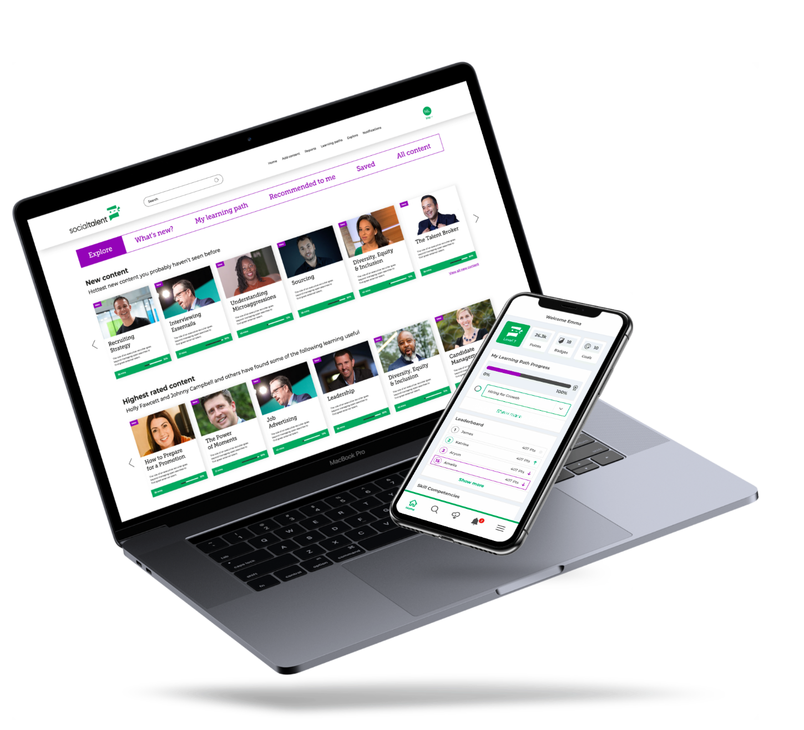
Desktop Tour

Slide 16
What’s next?

Slide 17
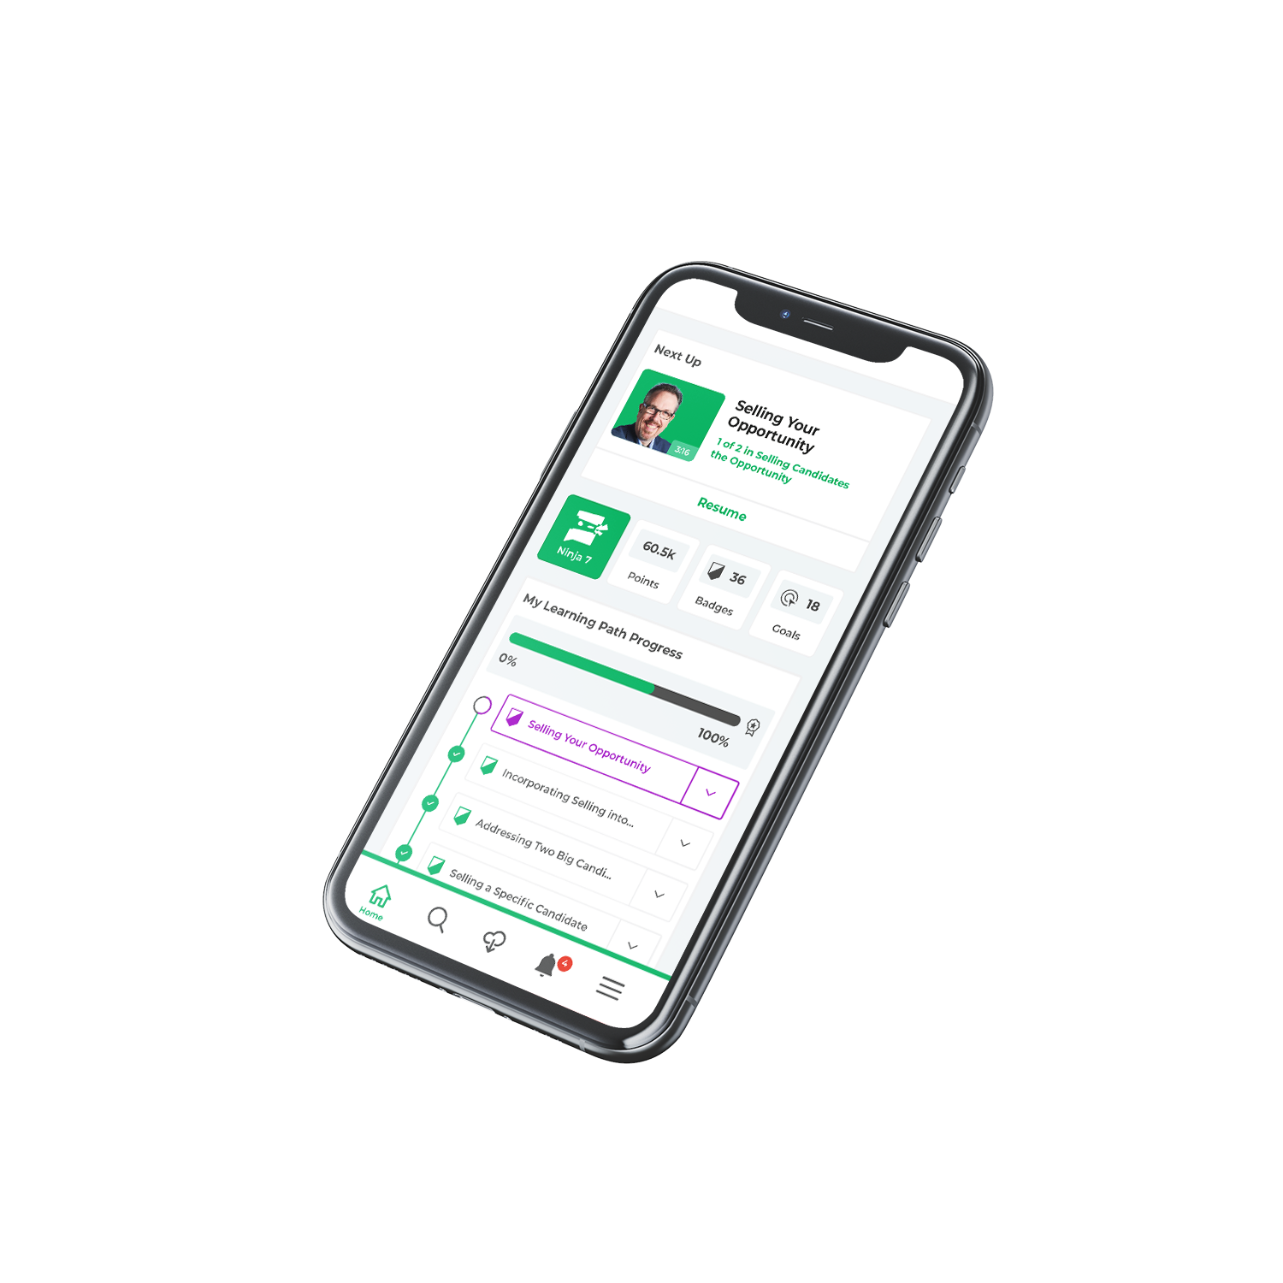
Next Steps and Best Practice
Pick a time to do your weekly learning
Celebrate achieving badges and certificates
Download the mobile app
Discuss learning with your colleagues
Practice your new skills each week

Slide 18

This Week
Check your email for login details – your login details were sent
Log in and get started – TIP: watch one hour this week to get well acquainted with your learning.
Enjoy and reach out with any questions.
Any technical/login questions: support@socialtalent.com
Any other questions: aoife.halliden@socialtalent.com

Slide 19
A Successful Learning Program Requires a Strong Team
Our Organization:
Role | Description | Responsibilities
Account Manager | Steward of the relationship between SocialTalent and your organisation. | Oversees the partnership between ST and your organisation. Ensures strategic alignment & value delivery Main POC for your Exec Sponsors Drives strategic alignment meetings, such as QBR's Oversees all commercials (e.g. contract renewals, etc.)
Onboarding Specialist | Oversees all aspects of your set-up, with a view of accelerating your time to value. | Assists with platform & learning configuration Coordinates with ST technical resources to deploy integrations Provides training to PM's & Admins Supports your team through initial launch Contributes to Mutual Success Plan (MSP)
Customer Success | Provides resources & guidance on how best to meet your objectives. | Partners with your Program Manager to help drive your ST learning program Drives the Mutual Success Plan (MSP) Provides guidance & resources to maximise learner engagement Drives Program Health Review meetings & attends other meetings such as QBR's
Customer Support | Resolves technical/platform issues experienced by learners & admins. | Responds to all support tickets Troubleshoots end-user issues Liaises with ST Product team to resolve bugs
Questions

Slide 20



