Slide 1
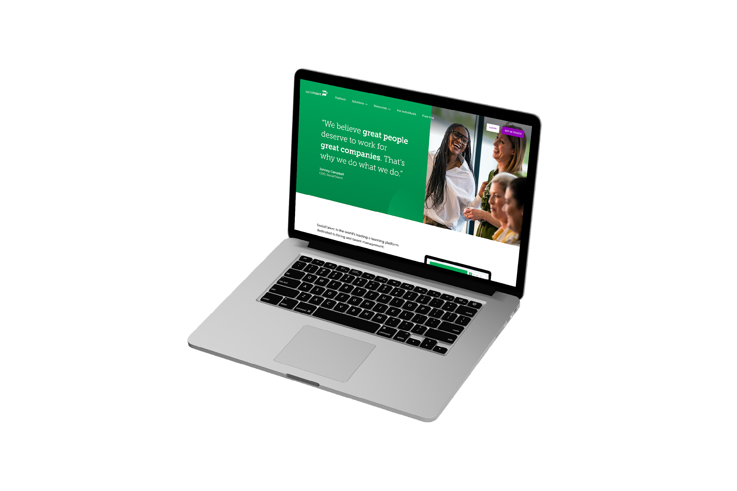
Hire, Lead, and Engage with SocialTalent
Date

Slide 2
SocialTalent + US Bank
Today’s agenda
Our team objectives
Roadmap to success
Learning expectations
Our learning program
SocialTalent platform tour
Best practice
Questions

Slide 3
Our TA/Hiring Objectives
1
2
3
4
(Reduce time to hire)
(Create a world-renowned candidate experience)
(Increase representation of diverse groups in our business)
(Ensure career development opportunities for all staff)

Slide 4
Our Path to success
Reduce time to hire
New process segmented by candidate type
Implementation of new sourcing tools
Learning on sourcing & candidate engagement
Candidate Experience
Collect candidate NPS
Project team for seamless experience
Automated alerts in ATS for follow ups
Learning on understanding candidates
Diversity
Focus group of current staff – collect and use feedback
Blind resume screening
Track our metrics
Learning on sourcing for diversity and inclusive recruiting
Career Progression
Defined career pathways in TA
Hyper-relevant learning programs to support this
Learning for managers on internal mobility

Slide 5
Our learning program
Q1: Reduce time to hire
Q2: Candidate Experience
Q4: Career Progression
Q3: Diversity
Learn 30 minutes per week with SocialTalent
Complete 6 hour learning path in Q1
Attend biweekly discussions
Achieve certification
Learn 30 minutes per week with SocialTalent
Complete 6 hour learning path in Q2
Attend biweekly discussions
Achieve certification
Learn 30 minutes per week with SocialTalent
Complete 6 hour learning path in Q3
Attend biweekly discussions
Achieve certification
Learn 30 minutes per week with SocialTalent
Complete 6-10 hour learning path in Q4
Attend biweekly discussions
Achieve certification

Slide 6
What your learning looks like
Practice
new skills daily
Bi-weekly
30 minutes
Put new skills into practice right away
We will host some roleplays and workshops too!
team discussions
weekly learning
Come prepared to share your takeaways, feedback and practice
Combination of your learning path and exploring other topics
‹#›

Slide 7
Our partners in SocialTalent
YOUR PICTURE HERE
(If you don’t have a professional image, please arrange to meet Niall in Huckletree for one at earliest convenience)
What will you learn?
How to navigate the SocialTalent learning platform
Learning best practice
Q&A
Your Name here
Job Tile
first.last@socialtalent.com

Slide 8
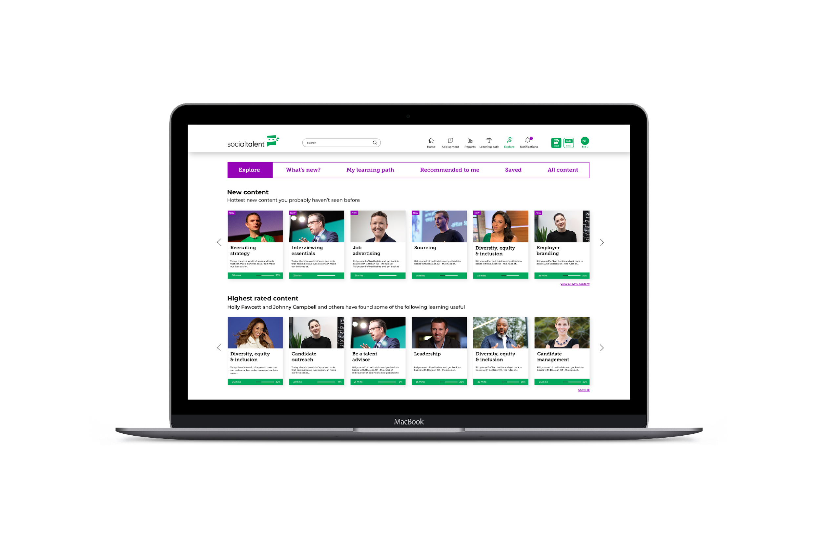
SocialTalent empowers organizations to hire, lead, and engage top talent.
Mobile and desktop
Recruiting, Interviewing, Onboarding, DEI, Internal Mobility, and Leadership training content.​
Inclusive learning platform with video, audio, and text-based options.​
Scalable and secure learning environment.​
Easily integrate with learning management systems.*​
New content released regularly.​
Available in multiple languages.**​
*Premium add-on​
**Provided in English by default.​

Slide 9
Your Q1 Learning Path
TBC and updated if needed
Licensed Candidate Management Specialist
Candidate experience:
What candidates really want
Candidate experience:
How candidates decide their next move
How to give great feedback to candidates
Duration:
Completion date: 31st July
Weekly learning goal: 30 mins

Slide 10
A Successful Learning Program Requires a Strong Team
Our Organization:
Role | Description | Responsibilities
Account Manager | Steward of the relationship between SocialTalent and your organisation. | Oversees the partnership between ST and your organisation. Ensures strategic alignment & value delivery Main POC for your Exec Sponsors Drives strategic alignment meetings, such as QBR's Oversees all commercials (e.g. contract renewals, etc.)
Onboarding Specialist | Oversees all aspects of your set-up, with a view of accelerating your time to value. | Assists with platform & learning configuration Coordinates with ST technical resources to deploy integrations Provides training to PM's & Admins Supports your team through initial launch Contributes to Mutual Success Plan (MSP)
Customer Success | Provides resources & guidance on how best to meet your objectives. | Partners with your Program Manager to help drive your ST learning program Drives the Mutual Success Plan (MSP) Provides guidance & resources to maximise learner engagement Drives Program Health Review meetings & attends other meetings such as QBR's
Customer Support | Resolves technical/platform issues experienced by learners & admins. | Responds to all support tickets Troubleshoots end-user issues Liaises with ST Product team to resolve bugs
First Time Login

Slide 11
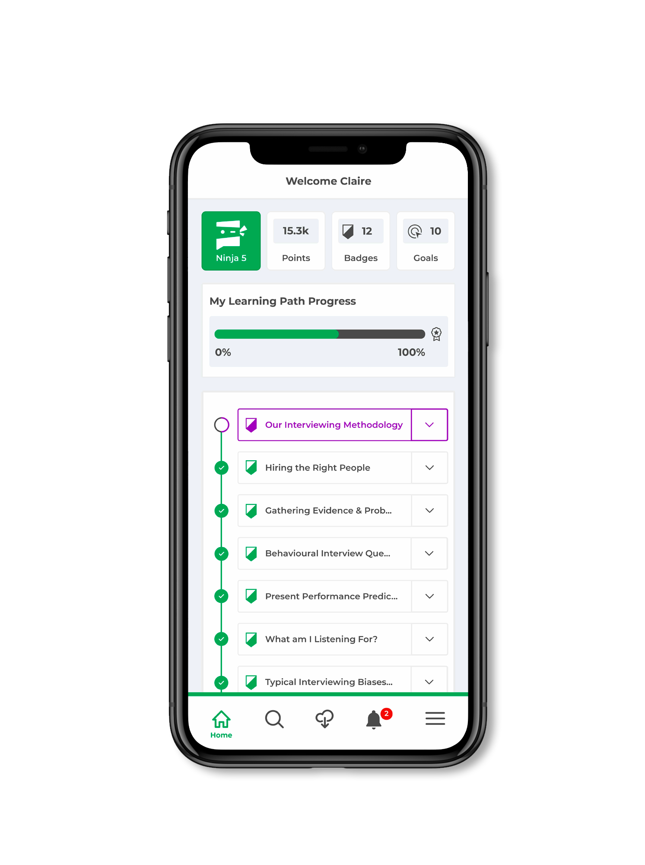
Welcome To SocialTalent

Slide 12
Welcome To SocialTalent

Slide 13
Welcome To SocialTalent

Slide 14
Desktop Tour

Slide 15
What’s next?

Slide 16
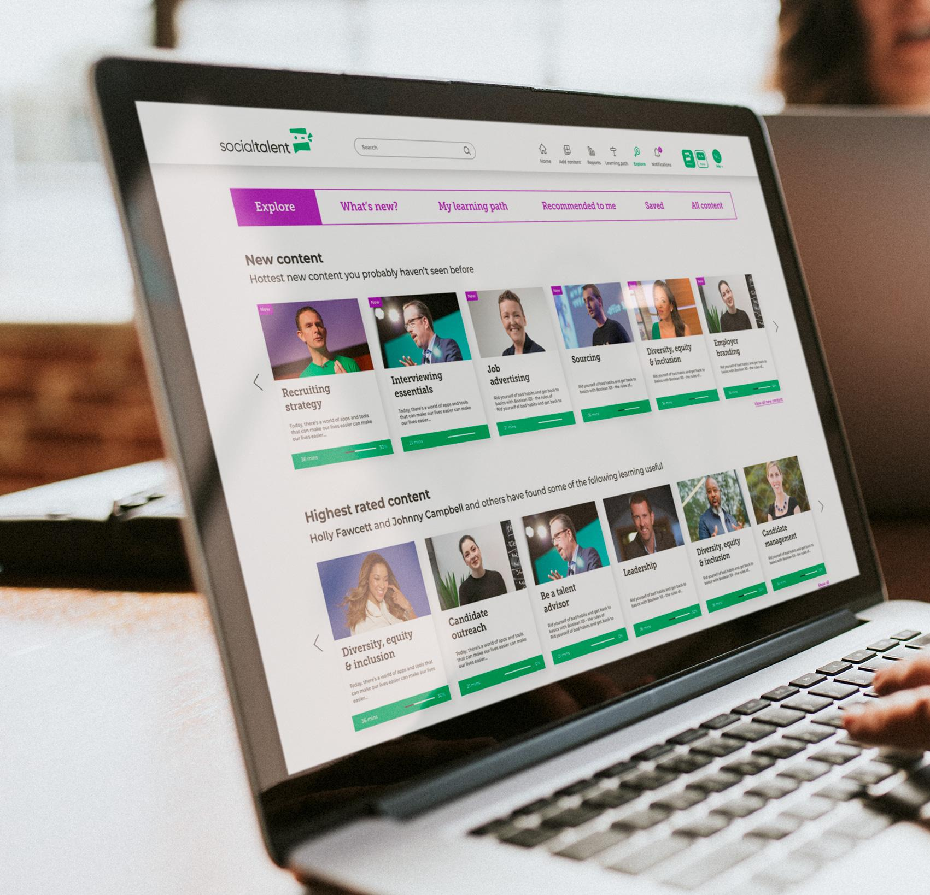
Next Steps and Best Practice
Pick a time to do your weekly learning
Celebrate achieving badges and certificates
Practice your new skills each week
Discuss learning with your colleagues

Slide 17
This Week
Check your email for login details – your login details were sent
Log in and get started – TIP: watch one hour this week to get well acquainted with your learning.
Enjoy and reach out with any questions.
Any technical/login questions: support@socialtalent.com
Any other questions: eamon.ho@socialtalent.com

Slide 18
A Successful Learning Program Requires a Strong Team
Our Organization:
Role | Description | Responsibilities
Account Manager | Steward of the relationship between SocialTalent and your organisation. | Oversees the partnership between ST and your organisation. Ensures strategic alignment & value delivery Main POC for your Exec Sponsors Drives strategic alignment meetings, such as QBR's Oversees all commercials (e.g. contract renewals, etc.)
Onboarding Specialist | Oversees all aspects of your set-up, with a view of accelerating your time to value. | Assists with platform & learning configuration Coordinates with ST technical resources to deploy integrations Provides training to PM's & Admins Supports your team through initial launch Contributes to Mutual Success Plan (MSP)
Customer Success | Provides resources & guidance on how best to meet your objectives. | Partners with your Program Manager to help drive your ST learning program Drives the Mutual Success Plan (MSP) Provides guidance & resources to maximise learner engagement Drives Program Health Review meetings & attends other meetings such as QBR's
Customer Support | Resolves technical/platform issues experienced by learners & admins. | Responds to all support tickets Troubleshoots end-user issues Liaises with ST Product team to resolve bugs
Questions

